Slide 1

Search Fundamentals
Algorithmic Problem Solving

Slide 2
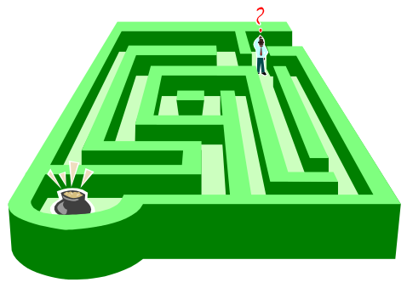
Searching for Solutions
Often the solution to a problem is a series of steps or actions.
We call some of these well-defined problems.
A well-defined problem has:
An Initial State
A Set of Goal States
A State Space (set of reachable states)
1+ Operators (finite set of steps or actions & consequences)
We often use search to find solutions to well-defined problems as the number of successors (branching factor) is finite for a given state.

Slide 3
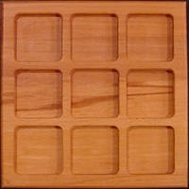








Search: The 8-Puzzle
Example:

Slide 4

Search Problems: The 8-Puzzle
Consider a systematic approach to the 8-puzzle.
Number of Nodes at 10-Ply: 4¹⁰ = 1048576 nodes
Number of Nodes at 55-Ply: ~1.52 · 10²⁵ nodes
Weight of the Earth: ~1.32 · 10²⁵ pounds
Total Board Configurations: 9·8·7·6·5·4·3·2·1 = 362880
There are more nodes than possible configurations! Why?

Slide 5
Search Problems: The 8-Puzzle
Example:
Duplicates!

Slide 6

Search Problems: Duplicates
We get duplicates because:
We get the same state from different action sets.
We could perform an infinite number of toggles.
When we eliminate duplicates…
We need less memory
We need less processing time
Difference in nodes: from 1.52 · 10²⁵ to 3.62· 10⁵!

